Slide 1
“Making Colombo a Globally Competitive City” The Case for ECA Financing
HSBC Project and Export Finance
Date: 4 November 2015

Slide 2
What ECA Financing brings to the table
Notes:
2

Slide 3
ECA Financing – A Globally Competitive Source of Financing
An attractive source of financing of imported capital goods and services worldwide, particularly in emerging markets.
Involves credit enhancement or direct lending from Export Credit Agencies (ECA) in the country of origin of the exporter and/or of the goods and services being procured.
Historically designed to finance international trade, but increasingly applied to support overseas expansion of companies through foreign direct investment.
Consistently used across emerging economies in Asia (eg. China, India, Indonesia, Bangladesh, Philippines, Sri Lanka, Vietnam) as well as developed markets (Australia, HK, Korea, etc.)
Primarily funded by international commercial banks or ECAs. Capital Markets solutions are available, progressively broadening global liquidity for the product.
Key sectors: infrastructure (power, water, transportation), resources (oil and gas, mining and metals), telecom, etc.

Slide 4
Tied ECA financing (“Buyer’s Credit”)
A loan facility extended to an importer (the Borrower) by a bank or financial institution to finance the cross-border purchase of capital goods or services from a supplier/exporter. The loan facility is guaranteed by an Export Credit Agency based in the Exporter's country.
Exporter
Commercial Contract
Borrower
Goods & Services
ECA Application
Payments to supplier
Loan Agreement
Principal & Interest + Premium
ECAs
Lender
(e.g. HSBC)
Export Credit Agency (“ECAs”) are government department or government-sponsored institutions with sovereign status, established to support and promote the export of capital goods and services from their country.
Guarantee / Support Agreement
Premium
4

Slide 5




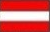
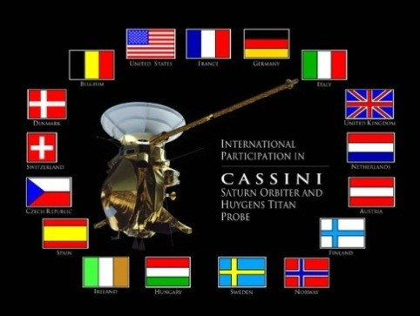






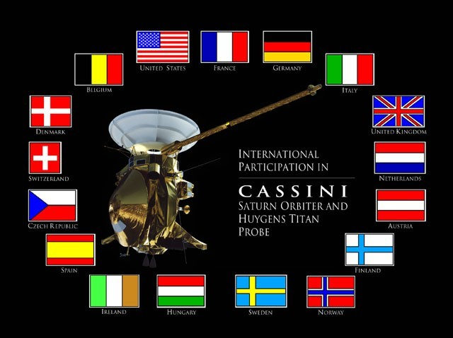
































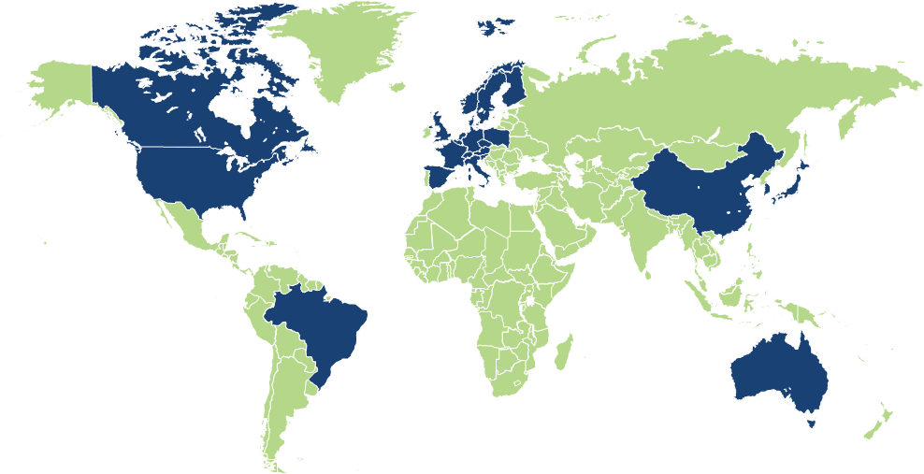





More than 30 ECAs available in funding projects
Austria
OeKB
Jens Klaus Richter
+ 49 211 910 1474
Belgium
Ducroire (formerly ONDD)
Gilles Pinot De Villechenon
+ 33 1 40 70 35 07
Czech Republic
EGAP
Alena Ockova
+ 420 225 024 591
Denmark
EKF
Andrew French
+ 44 207 992 2578
Finland
FINNVERA
Andrew French
+ 44 207 992 2578
France
COFACE
Gilles Pinot De Villechenon
+ 33 1 40 70 35 07
Germany
HERMES
Jens Klaus Richter
+ 49 211 910 1474
Hungary
Magyar Exim
Sam Lippitt
+ 44 207 991 6288
Holland
Atradius
Andrew French
+ 44 207 992 2578
Italy
SACE
Alessandro Mazzi
+ 39 02 72 43 72 50
Norway
GIEK
Andrew French
+ 44 207 992 2578
Poland
KUKE
Sam Lippitt
+ 44 207 991 6288
Russia
EXIAR
Marko Gucijan
+7 8495 721 1550
Spain
CESCE
Beatriz de la Hoz
+ 34 91 45 66 956
Slovakia
EximBanka
Sam Lippitt
+ 44 207 991 6288
Sweden
EKN
Andrew French
+ 44 207 992 2578
Switzerland
SERV
Jens Klaus Richter
+ 49 211 910 1474
United Kingdom
UKEF (formerly ECGD)
Anthony Lenihan
+44 207 992 2567
USA
Ex-Im
Carla Campos
+1 212 525 5569
Canada
EDC
Carla Campos
+1 212 525 5569
China
Sinosure
Iris Ren
+86 10 5999 8222
Japan
JBIC / NEXI
Eiji Kamiyabu
+81 (0)3 5203 3005
Korea
KEXIM / KSURE
Jung Hyun Jun
+82 (0)2 2004 0608
Brazil
BNDES
Vitor Gabrielli
+55 11 3847 5084
Australia
EFIC
James Dynon
+61 292552015

Slide 6
Key consideration of ECA financing for City infrastructures
Long-term funding vs. economic life of assets | Loan horizons of 10-15yrs are considerably longer than commercial bank market. Limited recourse and/or rail sector may attract longer tenors up to 20+yrs
Competitive all-in costs vs. affordability of infrastructure | All-in pricing tends to be competitive to commercial bank solutions or bond market due to low risk weighted assets for lenders. It is usually denominated in major currencies, can also be local currency in certain cases.
High loan amounts vs. large capital outlay | Up to 85% of a project cost. For infra projects with large capex outlay, ECAs are often able to take considerable levels of risk and commercial banks have much higher appetite to support ECA covered projects thanks to the credit enhancement. 100% financing packages can be assembled by the arranging bank
Attractive fixed rates of interest to mitigate interest rate risk | ECA-supported fixed Commercial Interest reference Rates (“CIRR”) typically cost less than commercially-arranged fixed-rate facilities and can be applicable for the life of the ECA facilities.
Multi-sourced ECA financing vs. diversified procurement structures | Multi-sourced ECA financing provides the Borrower with the possibility to finance series of contracts with several equipment providers from different countries under the same general multi-sourcing agreement involving the relevant ECAs.
Direct funding by certain ECAs vs. liquidity and risk appetite of commercial lenders | Provides substantial liquidity at attractive all-in rates, acting as a viable source of funding amidst volatile international market conditions and banks’ rising liquidity costs.
Smaller syndication / catalyst function of ECAs | For a large transaction, ECAs act as catalyst for other sources of funding. Relatively few banks need to come into the funding due to the ECA cover. This makes the syndication and documentation process more stream lined.
“Rapid” execution | ECA financing can be concluded rapidly in a time-frame comparable with other sources of hard-currency financing.
6

Slide 7
Examples of ECA Financing
Notes:
7

Slide 8

Government of Sri Lanka Phase II of the Regional Bridge Program
June 2013 Sri Lanka
Democratic Socialist Republic of
Sri Lanka
USD 60m ECGD Facility
USD 10.6m Commercial Facility
HSBC acted as Sole Arranger for the financing package in supply of the second phase of the Regional Bridge Program with the construction of 104 single and two lane steel bridges supplied by Mabey Bridge Limited.
Sole MLA
Transaction Highlights
The Ministry of Ports and Highways (“MPH”), acting on behalf of the Government of Sri Lanka, undertook an expansion of the second phase of the regional bridge program with the construction of 104 single and two lane steel bridges.
HSBC acted as MLA for the 100% financing of Mabey Bridge Limited (“Mabey”)‘s supply contract
for the supply, survey, design, installation and implementation of the 104 bridges.
Mabey relationship has grown through continued support from HSBC PEF franchise and the entire banking requirement supported through HSBC including issuing of performance bonds from the UK as well as the operating accounts of the local project office in Sri Lanka.
Repeat transaction following the 2003 and 2008 financing of the Sri Lanka Government’s bridge program. This highlights HSBC's key partnership role in the country's development program and long-running relationship with both (i) the borrower and (ii) the exporter.
This project will directly improve the quality of life and economic development of the rural population and to enhance their access to much needed education and health services.
Summary Terms and Conditions
Borrower | Government of Sri Lanka | EPC | Mabey Bridge Limited
ECAs | ECGD | Guarantor | N/A
Tenor | ECA: 4 + 10 years Commercial: 1 + 5 years | Amount | ECA: USD 60,071,625 Commercial: USD 10,600,875
Signing Date | 21st June 2013 | Currency | USD
Structure | Export Credit and Commercial | Use of Proceeds | Financing of 104 single and two lane steel bridges

Slide 9
Government of Sri Lanka Milco (Pvt) Ltd
August 2015 Sri Lanka
Democratic Socialist Republic of
Sri Lanka
USD equivalent of EUR56m EKF Facility
USD equivalent of EUR10m Commercial Facility
HSBC acted as Sole Arranger and Facility Agent for the financing of the supply, installation and commissioning of a new dairy processing facility of Milco in Badalgama to be supplied by Desmi, Denmark
Sole MLA, Facility Agent
Transaction Highlights
HSBC acted as sole MLA and Facility Agent for the 100% financing of Desmi Contracting A/S (“Desmi”)‘s supply contract for the supply, installation and commission of a new dairy processing facility of Milco (Pvt) Ltd (“Milco”) in Badalgama.
This transaction is a follow on post the financing of the 1st phase of the project concluded in 2013 to the Ministry of Finance Sri Lanka with Desmi (Denmark) acting as contractor for the refurbishing of milk factories located in Ambewela, Polonnaruwa and Digana.
The project consists of replacing the existing equipment in milk factories with new technology in order to increase the quality and the capacity of the dairy industry in Sri Lanka. The project will also help a large number of smallholders in rural areas to sell their milk, and help to reduce regional economic disparities and strengthen the economy in a sustainable manner.
This transaction is a testament to HSBC’s unrivalled understanding of Sri Lankan market gained from being present in the country for over 120 years and having participated in most of key transactions coming out of Sri Lanka.
This transaction further underpins HSBC's expertise in execution being the primary arranger of export credits to various projects under multiple lines of Ministries and leveraging its strong international network and prior experience with EKF.
Summary Terms and Conditions
Borrower | Government of Sri Lanka | EPC | Desmi Contracting A/S, Denmark
ECAs | EKF | Guarantor | N/A
Tenor | ECA: 3 + 10 years Commercial: 2 + 4 years | Amount | ECA: USD equivalent of EUR 56,580,214 Commercial: USD equivalent of EUR9,975,863
Signing Date | 14 August 2015 | Currency | USD
Structure | Export Credit and Commercial Facilities | Use of Proceeds | Financing of a new dairy processing facility of Milco

Slide 10




West Coast Power Limited 300MW Combined Cycle Power Plant
December 2007
West Coast Power Limited
EUR152,000,000
300MW Combined Cycle Power Plant
Sole Mandated Lead Arranger
Lender, Facility Agent, Security Agent
Export Credit Support From: COFACE, US Ex-Im Bank, Hermes, OeKB, Atradius, SACE and Kuke
Transaction Summary
The largest IPP in Sri Lanka with strong Government support from the Sponsors – Government of Sri Lanka, Lakdhanavi Limited, Lanka Electricity Company Limited and the Employees Provident Fund
The project is being funded by 30% equity and 70% bank debt. HSBC acted as Sole Mandated Lead Arranger and successfully raised EUR 152m from the ECAs and the commercial bank market
The financing package includes 14-yr ECA supported facilities and a 10-yr Commercial. Seven ECAs involved in the bank debt. New tenor benchmark set in the offshore commercial loan market – the longest tenor ever achieved in Sri Lanka for offshore commercial debt. The debt package represents the largest commercial borrowing in Sri Lanka
West Coast Power (Private) Limited acting as Borrower. Ministry of Finance provided a 100% unconditional guarantee for the debt obligations of the Borrower. West Coast Power (Private) Limited entered into a 25-yr PPA with CEB and a 25-yr FSA with CPC
Summary Terms and Conditions
Borrower | West Coast Power Limited | EPC | Lakdhanavi Limited
ECAs | COFACE, Ex-Im, Hermes, Atradius | Guarantor | Ministry of Finance
Tenor | 2 + 12 years | Amount | EUR152,000,000
Signing Date | 7 December 2007 | Currency | Euro
Structure | Export Credit and Commercial | Use of Proceeds | Financing of a 300MW combined cycle power plant

Slide 11


Petrovietnam – 2x 600 MW Thai Binh 2 Thermal Power Project USD 937m Multi-tranche financing package
December 2013 Vietnam
Vietnam Oil and Gas Group
USD 937m
2x 600 MW Thai Binh 2 Coal-Fired Thermal Power Plant
Coordinating Arranger, Mandated Lead Arranger, Lender, Facility Agent
Export Credit Support From:
KEXIM, NEXI/JBIC
Transaction Highlights
Petrovietnam, 100% owned by the Vietnam government, is the flagship company of the national oil and gas sector, responsible for developing the full hydrocarbon value chain in Vietnam
At USD 1.6bn, the Thai Binh 2 Thermal Power Project is one of the largest investments of Petrovietnam in the power sector to date following the success of the Vung Anh 1 power plant project. It is the first of several similar size coal-fired power projects being developed by the company
The USD 937.25m financing package was the largest debt raising by Petrovietnam to date and incorporates a USD 195.25m commercial facility
The transaction involved extensive and close cooperation between HSBC as Coordinating Arranger and its main banking partner as well as other international banks
The transaction further demonstrated HSBC’s commitment to Vietnam’s energy sector, and the strength of the bank’s Asian franchise
Summary Terms and Conditions
Borrower | Petrovietnam | EPC | Sojitz Daelim Consortium
ECAs | KEXIM. NEXI/JBIC | Guarantor | 100% Ministry of Finance
Tenor | 3+10, 3+7 (commercial) | Amount | 1.) USD 270m KEXIM covered Facility; 2.) USD 330m KEXIM direct; 3.) USD 195,25m Commercial Facility and 4.) USD 142m JBIC/NEXI Facility
Signing Date | 9 December 2013 (KEXIM), commercial TBD | Currency | USD
Structure | Export Credit and Commercial | Use of Proceeds | Financing of a 2x 600 MW Coal-Fired Power Plant

Slide 12


Ashuganj Power Station Company Limited, Bangladesh 450 MW South combined cycle gas fired power
December 2012 Bangladesh
Ashuganj Power Station Company Limited (“APSCL”)
USD 420m
Senior Debt Facilities supported by CESCE of Spain, Hermes of Germany, ONDD of Belgium and MIGA as part of the World Bank
Coordinating Arranger, Mandated Lead Arranger, Intercreditor Agent, Facility Agents, Onshore and Offshore Security Agent, Hedge Provider, LC Issuing Bank, Account Bank
Highlights
APSCL is the leading public sector generation company in Bangladesh. Its existing power generation units of 724 MW contributes about 15% of the country’s power generation sector
Strategic project for the Bangladesh government in addressing power shortages in the country, through higher efficiency and cost competitive new gas plants. The plant will commence generation in 2015 and sell its output to Bangladesh Power Development Board under a LT Power Purchase Agreement
100% financing of the project including EPC and financing costs as required by the Government, achieved through a combination of ECA supported facilities and MIGA supported facility. The debt is 100% guaranteed by the Ministry of Finance of Bangladesh
The 3 ECAs (CESCE, Hermes and ONDD) and MIGA provided support for USD 420m over 13 years, representing the largest commitment by ECAs and MIGA in Bangladesh to date, and the first involvement of ECAs and MIGA in Bangladesh’s power sector
Sizable support from MIGA (part of the World Bank Group), through the use of MIGA’s Non-Honoring of Sovereign Financial Obligation (“NHSFO”) cover, under both a debt facility and a long term interest rate hedge. This is MIGA’s largest transaction to date under the NHSFO cover
Execution in record time of 9 months from EPC Contract signing, an exceptional achievement for a debut Borrower / Guarantor, following an extensive due diligence process, and a complex financing structure involving 3 ECAs, MIGA, and 7 banks
Innovative financing plan developed and implemented by HSBC with full interest rate hedging effective from project completion. Long tenors and lowest all-in cost of financing achieved for the project
HSBC performed all major roles on the transaction demonstrating value to the Government and the client in providing seamless transaction execution and delivery, further highlighting HSBC’s strong franchise in ECA financing
Summary Terms and Conditions
Borrower | Ashuganj Power Station Company Limited | Total project cost | c. USD 690m
ECAs | Hermes, CESCE, ONDD and MIGA | Total ECA package | USD 420m
Tenor | 3+ 10 years | Facility Amount | USD 420m
Signing Date | December 2012 | Currency | USD
Structure | Term Facility | Use of Proceeds | Financing of the 450MW South power plant
Notes:
12

Slide 13

Modernisation of Baku – Tbilisi - Kars Railroad, Azerbaijan
Transaction Summary
April 2015 Azerbaijan
Azerbaijan
Railways
EUR 459m
EGAP-covered export credit facility to finance modernization of 600km of Baku – Boyuk Kasik railroad
Coordinating Arranger, MLA
The modernisation of the international railroad connecting Azerbaijan, Georgia and Turkey (cities of Baku – Tbilisi – Kars) is one of the major infrastructure projects to be implemented in Azerbaijan for the coming years. 600 km of the dual rail track between Baku and Boyuk-Kasik on the territory of the Republic of Azerbaijan is to be modernised under a new contract, supplies and works to be sourced from abroad and locally. The modernisation of the railroad is vital for the export of crude and other oil products from Azerbaijan.
HSBC Bank plc acted as Coordinating Arranger, MLA and Lender in a EUR459m export credit facility to finance supplies and works for the modernization project. The export credit facility, supported by EGAP, the official Export Credit Agency of the Czech Republic, has been provided to Azerbaijan Demir Yollari (ADY) and is guaranteed by the Ministry of Finance. The facility documentation was signed in April 2015, and utilisation of funds is to begin in June 2015.
HSBC formed a club of six international and Czech banks to fund the facility and assumed the Facility Agency role.
The contract for the modernisation was awarded to Moravia Steel a.s., a large steel group of the Czech Republic. Moravia Steel will supply machinery, rails and other steel components, provide design and engineering services and coordinate civil works. The company successfully completed the 1st phase of the modernisation of 300 km of the said railroad in 2014.
Transaction details
Borrower: | Azerbaijan Demir Yollari | Signing: | 14 April 2015
Loan Size: | EUR 459 million | Tenor: | 12.5 years door to door
Repayment: | 8 years from completion | Currency: | EUR
Use of Proceeds: | Financing of the modernisation of Baku-Tbilisi-Kars railroad | Guarantor: | Ministry of Finance, Republic of Azerbaijan
Supporting ECA: | EGAP, Czech Republic

Slide 14
Funding City Infrastructures – the example of BRTs
Notes:
14

Slide 15
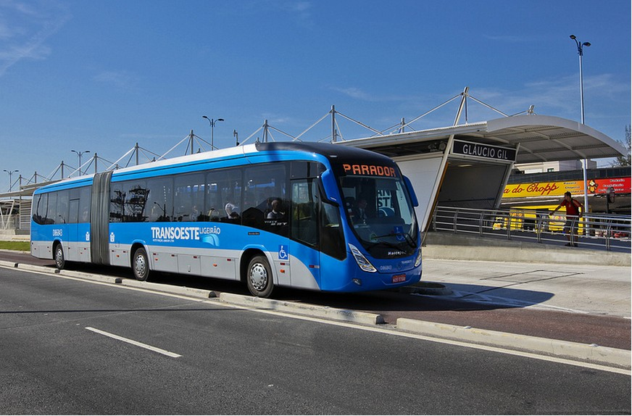
Bus Rapid Transit (BRT) financing
HSBC has already helped deliver 6 of the world’s major BRT projects
HSBC is the only bank with a dedicated BRT team.
We have arranged 43 BRT financings with 2 more currently
in credit approval stage.
We have worked alongside commercial banks, Multilaterals and Development Finance Institutions and have been extremely
successful in bringing Export Credit Agencies into BRT projects.
HSBC has acted as advisor to Cities and Government entities
on BRT projects and is the only commercial bank in the UN’s Sustainable Low Carbon Transport (SLoCAT) partnership.
We have helped to establish 8 special purpose companies (SPCs) to operate within BRT projects and act as borrowers under the financing. We can arrange off balance sheet financing.
We also currently work as Security Agent, Financial Agent and Trustee Bank for a number of BRT projects including Transmilenio and Rea Vaya.
We have strong relationships with Bus and AFC suppliers, BRT think tanks, operators, Cities and Ministries of Transport.

Slide 16

What are the typical sources of financing for BRTs
Central government or City funding
Multilaterals and Bi-laterals – World Bank, IFC, ADB, NIB, DBSA, IADB, CAF
Commercial Banks
Concessionaire Equity/commercial financing
Export Credit Agencies
The largest sources of funding for BRTs are Central Government funds and Export Credit Agencies
HSBC has arranged more than USD1.5bn of financing for BRTs

Slide 17















HSBC Supported BRT projects Global support to the sector across globe
Mexico City Metrobús – CISA / Mexico
Transporte Masivo de Panama / Panama
Supply of Buses /
Caribbean
Bus System Renewal Budapest / Hungary
Accra BRT / Ghana
Bogota Elektrika /
Colombia
Transmilenio Bogota /
Colombia
Hungary
Supply of Buses /
Hong Kong
Mexico
Caribbean
Sri Lanka
Hong Kong
Panama
Colombia
Accra, Ghana
Manaus, Brazil
Tshwane, South Africa
Bogota Express /
Colombia
Peru
Brazil
Tshwane BRT/
South Africa
Chile
Johannesburg, South Africa
Scania Latin America/
Peru
Transantiago Rapid Bus / Chile
Manaus BRT
Brazil
Volvo do Brasil /
Latin America & Caribbean
City of Johannesburg /
South Africa

Slide 18





Why is Export Credit Agency (ECA) financing potentially very valuable for BRT project?
ECA financing typically increases the availability of financing options and enhances the borrower’s financing terms
Benefits of ECA Financing
Low Cost
Does not utilise local market risk appetite (keeping funding lines open for the Government, Cities and Bus Operating Companies)
10 year repayment terms allow financing costs to be spread across the life of the concession
Grace periods allow the Bus Operator or City to start to generate income from the Project before it has to make the first repayments
ECAs can be more flexible if there are problems in the future than commercial lenders

Slide 19
Combining ECA and Development Agency financing works for BRTs
HSBC has arranged more than USD1.5bn of financing for BRTs
Most of the HSBC financings to date are structured under a Project Finance risk (i.e. no corporate/city guarantees attached)
Door to door repayment profile of 12 years
Average grace period of 2 years
Multilateral Development Bank Funding
Government or Grant Funding
Export Credit Agency
Guarantee 95% of loan political/ commercial risks
Finance charge
Funds for bus purchases and construction of depots
HSBC as ECA lender and overall security/paying agent
Operator
Ticket Revenue
Finance charge
Repayment of Loan.
All Operator Income
Debt Service Accrual A/C
Deposits
Collection A/C
Deposits
Debt Service Reserve Account
19

Slide 20
What an experienced arranger can do …
Approach the Bus/ BRT project from a project finance angle and not from the typical government or corporate finance angle (i.e. non recourse structure to the Parent company)
Introduce the Cities and minibus taxi associations/existing bus operators to International BRT “players”
There are over 120 BRTs in operation with a further 100 in planning/expansion – HSBC is targeting 40 of these BRTs with a potential for 10,000 new buses at a cost of USD2bn
Advise on BRT concession contract wording
The need to consider both financial and operational issues, appropriate risk allocation throughout contractual structure
Provide advice on BRT project risks and mitigants
Up-to-date experience of a large number of projects
Assist in negotiations with National/Regional Government
BRT is often a poorly understood concept with a need for coordination amongst various Government agencies
Run workshops for Cities/Operators to review risks of Project
Arrange any additional required financing alongside the Export Finance facility or other

Slide 21
Making Colombo a Globally Competitive City… faster
HSBC has taken the following roles in BRTs
Helping to develop and manage the BRT project structure with a focus on avoiding pitfalls seen in other projects
Advising potential risks, running risk workshops and providing project reviews for the Mayoral committee
Arranging roadshows to potential external sources of financing
Advising on hedging strategies
Bringing local funders on board
Helping to draw up a timeline for the project and co-ordinating the delivery of key elements of the Project
Reviewing the financial model
Drawing up a Project Information Memorandum and helping to draft the operator concession document
Creating the SPC that became the borrower and interim operator
Providing payment guarantees to the bus supplier
Liaising with the National Treasury and National Department of Transport
Drawing up loan and security documentation and delivering the ECA financing
Setting up the security structure
Providing working capital facilities for the SPC

Slide 22
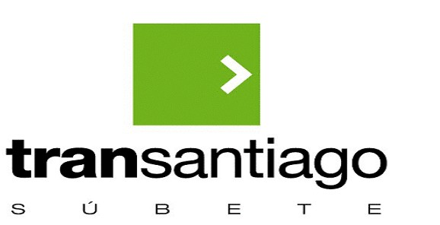
ECA Experience with BRT systems: Transantiago – Chile
Multi-sourced ECA and Multilateral Financing
Transaction Highlights
Transantiago
USD 674,000,000
EKN
NEXI
NIB
Sole Lead ECA Arranger, Security Agent, Account Bank, Intercreditor, NEXI facility Lead Arranger and Agent, NIB Joint Arranger
Export Credit Support From:
NEXI, EKN
On-Going
Government of Chile - Ministry of Transportation and Telecommunications (MTT) redesigned the entire public transportation system for the capital city of Transantiago.
Project included a complete overhaul of the existing system with the replacement of the 3,000 existing bus owner/operators with 11 SPC incorporated companies. The system included implementation of prepaid smart cards, integration of metro (subway) with buses, and elimination of competition for bus routes. This was recognised as the largest ever change of a public transportation system.
HSBC arranged USD 674m of financing for 3 SPC operators to finance the purchase of over 2500 Volvo buses which were delivered in a record time frame to be available for start-up of Projects.
The multi-sourced financing provided long-term fixed and floating rate facilities denominated in US dollars and some local currency (Chilean Peso) to these start up Project companies. This was recognised by Chilean authorities as a success story of the start-up of the Project and key to the overall goals of renewing the bus fleet with new low emission buses.
Summary Terms and Conditions
Borrower
ECAs
Tenor
Signing Date
3 SPC Bus Operators
EKN, NEXI
12 years
Various and Ongoing
Total Loan Amount
Currency
Use of Proceeds
Over USD 674m to date
US Dollars
Financing for purchase of over 2,000 Volvo buses to date, working capital, and purchase of bus depots and construction of operating facilities

Slide 23
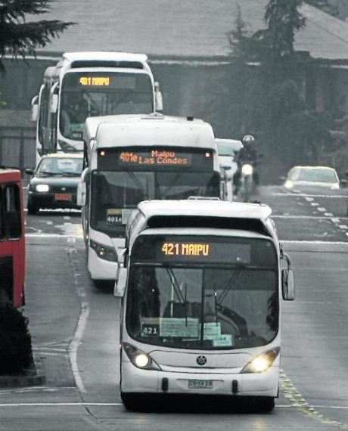
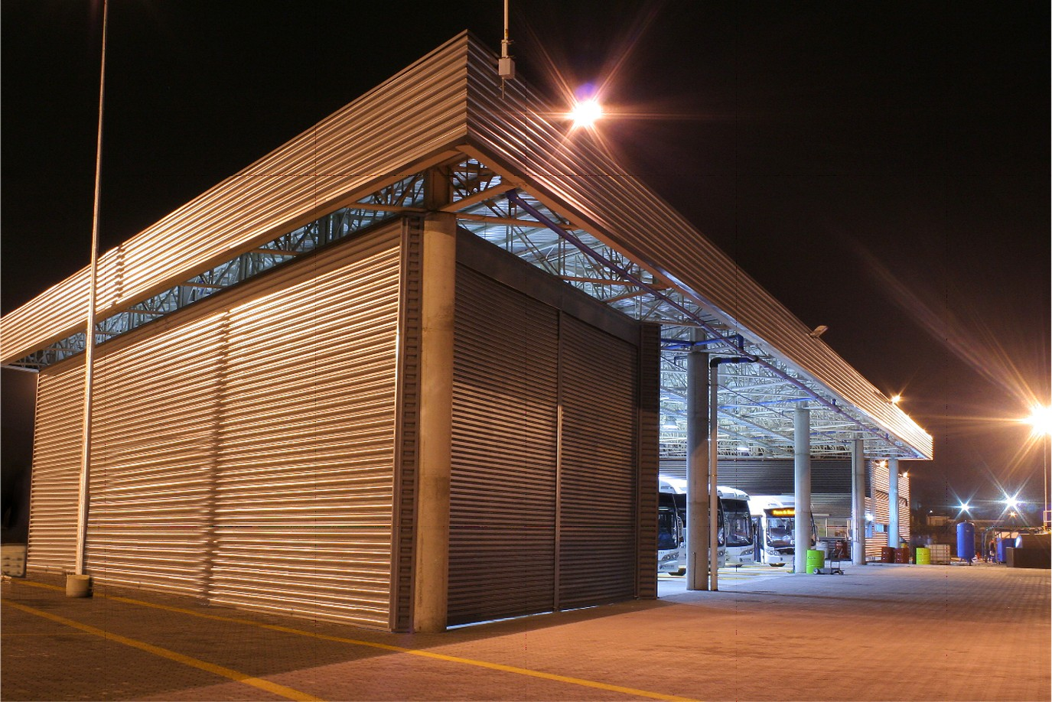
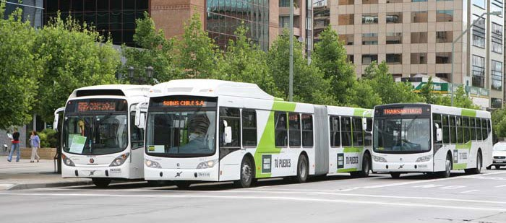
ECA Experience with BRT systems: Transantiago – Chile

Slide 24
Disclaimer
The Global Banking and Markets division of The Hongkong and Shanghai Banking Corporation Limited (“HSBC”) has prepared this document (the “Document”) for information purposes only. This Document does not constitute a commitment to underwrite or purchase or subscribe for all or any portion of any securities mentioned herein or otherwise or to provide any financing. Any such commitment shall be evidenced only by a fully executed agreement. This Document should also not be construed as an offer for sale of or subscription for any investment, nor is it calculated to invite/solicit any offer to purchase or subscribe for any investment.
HSBC has based this Document on information obtained from sources it believes to be reliable but which it has not independently verified. HSBC makes no guarantee, representation or warranty and accepts no responsibility or liability for the contents of this Document and/or as to its accuracy or completeness and expressly disclaims any liability whatsoever for any loss howsoever arising from or in reliance upon the whole or any part of the contents of this Document. HSBC does not undertake, and is under no obligation, to provide any additional information, to update this Document, to correct any inaccuracies or to remedy any errors or omissions in this Document. You are solely responsible for making your own independent appraisal of and investigations into products, investments and transactions referred to in this Document, related thereto and otherwise, and you must not rely on any information in this Document as constituting investment advice. No consideration has been given to the particular investment objectives, financial situation or particular needs of any recipient. HSBC and its affiliates and/or its or their respective officers, directors and employees may have positions in any securities mentioned in this Document (or in any related investment) and may from time to time add to or dispose of any such securities (or investment). HSBC and/or any of its affiliates may act as market maker or have assumed an underwriting commitment in the securities of any companies discussed in this Document (or in related investments), may sell them to or buy them from customers on a principal basis and may also perform or seek to perform banking or underwriting services for or relating to those companies. As HSBC is part of a large global financial services organisation, it or one or more of its affiliates may have certain other relationships with the parties relevant to the proposed activities as set out in this Document, and these proposed activities may give rise to a conflict of interest, which the addressee hereby acknowledges and which will be addressed accordingly.
The Hongkong and Shanghai Banking Corporation Limited Level 16 HSBC Main Building 1 Queen’s Road Central Hong Kong SAR
© Copyright. The Hongkong and Shanghai Banking Corporation Limited 2006-15, ALL RIGHTS RESERVED. No part of this publication may be reproduced, stored in a retrieval system, or transmitted, on any form or by any means, electronic, mechanical, photocopying, recording, or otherwise, without the prior written permission of The Hongkong and Shanghai Banking Corporation Limited.

